Slide 1
Unit 4
7.1: Variable Notation
7.2: Solving Linear Equations
7.3: Applying the Distributive Property in Solving Equations
7.4: Solving Linear Equations with Fractions and Decimals by Clearing the Denominators
7.5: Formulas

Slide 2


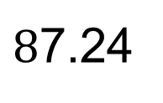

Introduction to Algebra
Constant – a number (does not change value)
$$\frac{1}{2}$$
$$8$$
$$34$$
$8$7.24

Slide 3
Introduction to Algebra
Variable – a symbol used to represent an unknown quantity
$$x y w β φ$$

Slide 4
Introduction to Algebra
Value of a variable – a number that replaces a variable
$$Let x=3 means the value of x is 3.$$
$$Let x=7 means the value of x is 7.$$

Slide 5
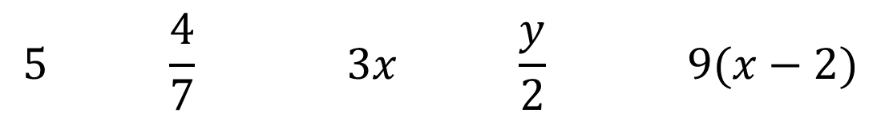
Introduction to Algebra
Term
– product or quotient of constants and/or variables
– anything separated by “+” or “-”
$$5 \frac{4}{7} 3x \frac{y}{2} 9(x−2)$$

Slide 6


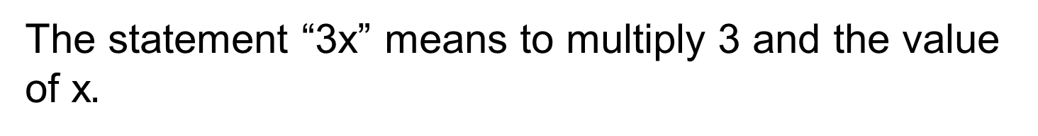
Introduction to Algebra
(Numerical) Coefficient – constant factor of a term
$$The 3 in the 3x.$$
$$The 5 in the 5y.$$
The statement “3x” means to multiply 3 and the value of x$.$
Expression – sum(or difference) of terms

Slide 7

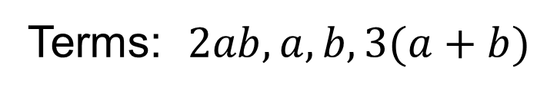

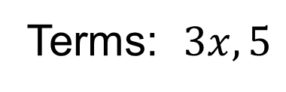
Identifying Terms and Coefficients
Identify the terms of each expression. (Example)
$$a) 3x+5 b) 2ab+a−b+3(a+b)$$
$$3x+5$$
$$2ab+a−b+3(a+b)$$
Addition sign
Addition(subtraction) signs
Terms: $3x,5$
Terms: $2ab,a,b,3(a+b)$

Slide 8

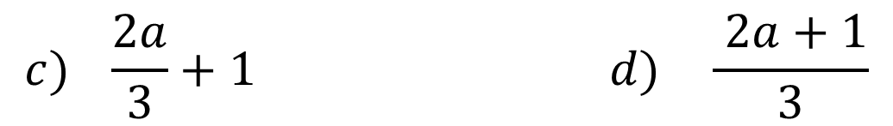
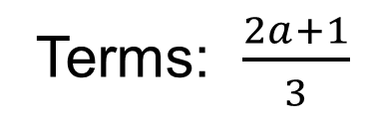

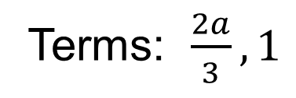
Identifying Terms and Coefficients
Identify the terms of each expression. (Example)
$$c) \frac{2a}{3}+1 d) \frac{ 2a+1}{3}$$
$$\frac{2a}{3}+1$$
$$\frac{2a+1}{3}$$
Addition sign
Terms: $\frac{2a+1}{3}$
Terms: $\frac{2a}{3},1$

Slide 9
English to Math Translations
Words and Phrases That Mean “Add”
“Total” “Sum” “Increased by” “More than”

Slide 10
English to Math Translations
Words and Phrases That Mean “Subtract”
“Difference” “Less than” “Decreased by” “Subtracted from”

Slide 11
English to Math Translations
Words and Phrases that Mean “to multiply”
“Multiplied by ” “Product” “Times” “Twice”

Slide 12
English to Math Translations
Words and Phrases that Mean “to divide”
“Divide” “Quotient” “Shared equally” “Per”

Slide 13
English to Math Translations
“A number” implies a variable.
“Is” represents equals.
“The quantity” implies parentheses.

Slide 14









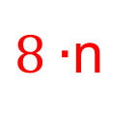
English to Math Translations
Translate each statement into a mathematical expression or equation. (Example)
$$Twice a number decreased by seven is five.$$
$$2∙n$$
$$−$$
$$7$$
$$=$$
$$5$$
$$2n−7=5$$
$$The product of eight and a number is ten.$$
$8∙$n
$$=$$
$$10$$
$$8n=10$$

Slide 15









English to Math Translations
Translate each statement into a mathematical expression or equation. (Example)
$$Thirteen less than a number is twenty−one.$$
$$13$$
$$n−13$$
$$=$$
$$21$$
$$n−13=21$$
$$Four times the sum of a number and three is one.$$
$$4$$
$$∙$$
$$(n+3)$$
$$=$$
$$1$$
$$4\left(n+3\right)=1$$

Slide 16

Write the following verbal expressions as mathematical expressions. Use x to represent the un- known quantity. Note that other letters can also be used to represent this unknown quantity. (Skill Check)
5 more than a number is 12. 5 + x= 12
A number divided by 6 is 9.
$\frac{x}{6}=9$

Slide 17
(c) 4 times the difference of a number and 3 is 12
4(x – 3) = 12
(d) If 15 mL of water are added to a medicine, there are 45 mL in all.
x + 15 = 45

Slide 18


Math to English Translations
Translate each equation into a sentence. (Example)
$$x−10=5$$
A number decreased by ten is five.
$$−6x+4=12$$
The product of negative six and a number increased by four is twelve.

Slide 19


Math to English Translations
Translate each equation into a sentence. (Skill Check)
$$3x=15$$
Three times a number is fifteen.
$$2\left(x+5\right)=13$$
The product of two and the sum of a number and five is thirteen.

Slide 20



Solution to an Equation
A solution to an equation is a value for a variable
that when substituted for the variable in the equation, the equation is a true sentence.
$$x=2 is a solution to 4x −3=5 since$$
$$4\left(2\right)−3=5$$
$$8−3=5$$
True sentence
$$5=5$$

Slide 21




Solution to an Equation
$$x=6 is NOT a solution to 4x −3=5 since$$
$$4\left(6\right)−3=5$$
$$24−3=5$$
False sentence
$$21=5$$

Slide 22

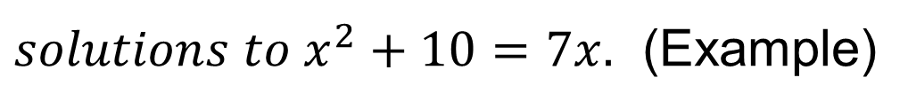




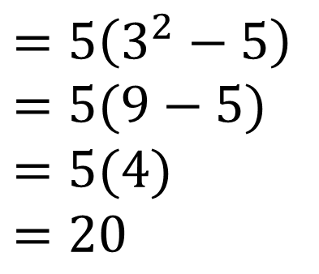


$$Determine which of the values 2, 4, or 5 are$$
$solutions to x^{2}+10=7x.$ (Example)
$$2^{2}+10=7(2)$$
$$4^{2}+10=7(4)$$
$$5^{2}+10=7(5)$$
$$4+10=14$$
$$16+10=28$$
$$25+10=35$$
$$14=14$$
$$26=28$$
$$35=35$$
True!
True!
False!
2 and 5 are solutions to the equation $x^{2}+10=7x$

Slide 23








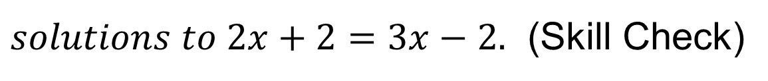

$$Determine which of the values 1, 2, or 4 are$$
$solutions to 2x+2=3x−2.$ (Skill Check)
$$2\left(1\right)+2=3\left(1\right)−2$$
$$2\left(2\right)+2=3\left(2\right)−2$$
$$2\left(4\right)+2=3\left(4\right)−2$$
$$2+2=3−2$$
$$4+2=6−2$$
$$8+2=12−2$$
$$4=1$$
$$6=4$$
$$10=10$$
False!
False!
True!
4 is a solution to the equation $2x+2=3x−2$

Slide 24
Solving Equations
“To solve an equation” means to use a designated algorithm (method) to systematically determine the value of a variable that is the solution to the equation.
This requires knowledge in two fundamental properties of equality.

Slide 25

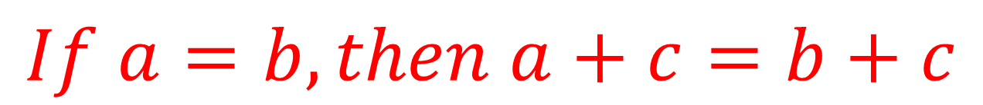

Addition Property of Equality
$$If a=b, then a+c=b+c$$
This means that if the equation is balanced, it will remain balanced if you add the same value to both sides of the equation.
$$6=4+2$$
$$6+3=4+2+3$$

Slide 26

Addition Property of Equality
$$If a=b, then a+c=b+c$$
Note: Also works for Subtraction!
$$6=4+2$$
$$5−7=4+1−7$$

Slide 27
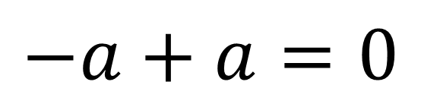
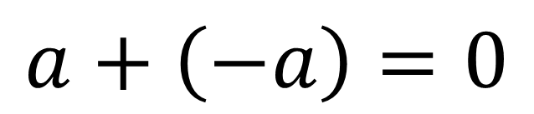
Additive Inverses
$$a+\left(−a\right)=0$$
$$−a+a=0$$
$$7+\left(−7\right)=0$$
$$−8+8=0$$
$$x+\left(−x\right)=0$$
$$−2x+2x=0$$

Slide 28
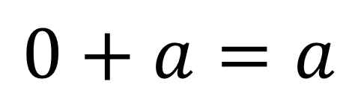
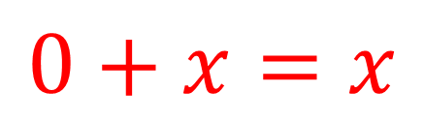
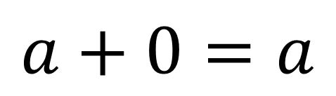
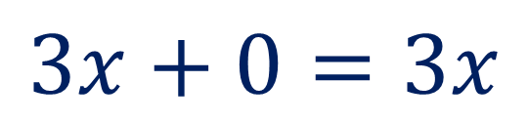
Addition Property of 0
$$a+0=a$$
$$0+a=a$$
$$5+0=5$$
$$0+\left(−9\right)=−9$$
$$3x+0=3x$$
$$0+x=x$$

Slide 29
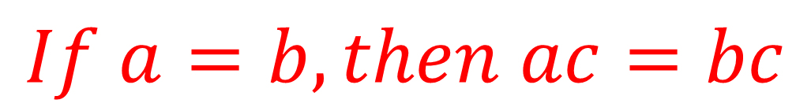

Multiplication Property of Equality
$$If a=b, then ac=bc$$
This means that if the equation is balanced, it will remain balanced if you multiply both sides of the equation by the same value.
$$6=4+2$$
$$6·3=\left(4+2\right)3$$

Slide 30

Multiplication Property of Equality
$$If a=b, then ac=bc$$
Note: Also works for Division!
$$6=4+2$$
$$6/3=\left(4+2\right)÷3$$

Slide 31
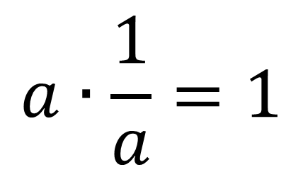
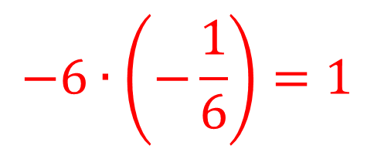
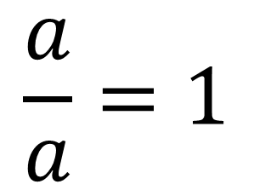
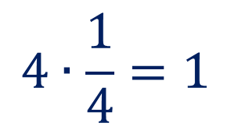
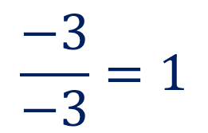
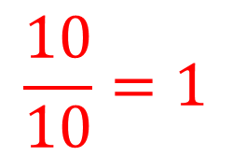
Multiplicative Inverses
$$\frac{a}{a}=1$$
$$a∙\frac{1}{a}=1$$
$$\frac{10}{10}=1$$
$$4∙\frac{1}{4}=1$$
$$\frac{−3}{−3}=1$$
$$−6∙\left(−\frac{1}{6}\right)=1$$

Slide 32
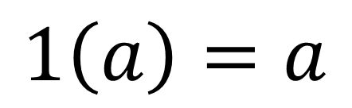
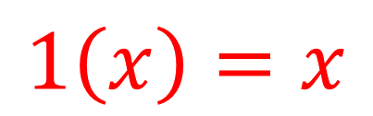
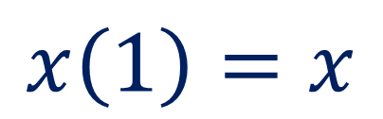
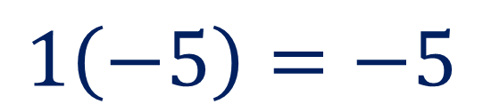
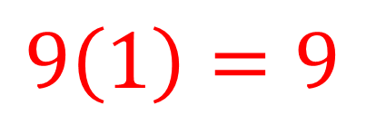
Multiplication Property of 1
$$a\left(1\right)=a$$
$$1\left(a\right)=a$$
$$9\left(1\right)=9$$
$$1\left(−5\right)=−5$$
$$x\left(1\right)=x$$
$$1\left(x\right)=x$$

Slide 33
Steps to Solve Equations
Clear Fractions
Get Rid of ( )
Combine Like Terms:
Same Side of =
Combine Like Terms:
Opposite Side of =
Addition Property
Solve for Variable
Multiplication Property
+ ↔ -
x ↔÷

Slide 34





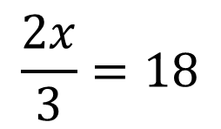
Steps for Solving a Linear Equation
Examples: Solve the following equations.
$$3x+7x=60$$
$$24−2b=6b$$
$$10−2a=4$$
$$6−2y=3y+36$$
$$\frac{2x}{3}=18$$
$$12x−18=8x+10+2x$$

Slide 35

Steps for Solving a Linear Equation
Clear Fractions
Get Rid of ( )
Combine Like Terms:
Same Side of =
Combine Like Terms:
Opposite Side of =
Addition Property
Solve for Variable
Multiplication Property
$$3x+7x=60$$

Slide 36


Steps for Solving a Linear Equation
Clear Fractions
Get Rid of ( )
Combine Like Terms:
Same Side of =
Combine Like Terms:
Opposite Side of =
Addition Property
Solve for Variable
Multiplication Property
$$3x+7x=60$$
$$10x=60$$
X

Slide 37

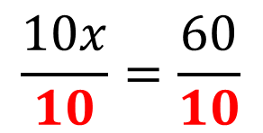
Steps for Solving a Linear Equation
Clear Fractions
Get Rid of ( )
Combine Like Terms:
Same Side of =
Combine Like Terms:
Opposite Side of =
Addition Property
Solve for Variable
Multiplication Property
$$3x+7x=60$$
$$10x=60$$
X
$$\frac{10x}{10}=\frac{60}{10}$$
$$x=6$$
x ↔÷

Slide 38

Steps for Solving a Linear Equation
Clear Fractions
Get Rid of ( )
Combine Like Terms:
Same Side of =
Combine Like Terms:
Opposite Side of =
Addition Property
Solve for Variable
Multiplication Property
$$10−2a=4$$
X

Slide 39



Steps for Solving a Linear Equation
Clear Fractions
Get Rid of ( )
Combine Like Terms:
Same Side of =
Combine Like Terms:
Opposite Side of =
Addition Property
Solve for Variable
Multiplication Property
$$10−2a=4$$
X
$$10−2a−10=4−10$$
$$−2a=−6$$
+ ↔ -

Slide 40
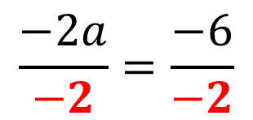

Steps for Solving a Linear Equation
Clear Fractions
Get Rid of ( )
Combine Like Terms:
Same Side of =
Combine Like Terms:
Opposite Side of =
Addition Property
Solve for Variable
Multiplication Property
$$10−2a=4$$
X
$$10−2a−10=4−10$$
$$−2a=−6$$
+ ↔ -
$$\frac{−2a}{−2}=\frac{−6}{−2}$$
x ↔÷
$$a=3$$

Slide 41
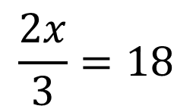
Steps for Solving a Linear Equation
Clear Fractions
Get Rid of ( )
Combine Like Terms:
Same Side of =
Combine Like Terms:
Opposite Side of =
Addition Property
Solve for Variable
Multiplication Property
$$\frac{2x}{3}=18$$
X
X

Slide 42
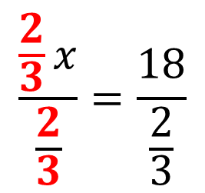

Steps for Solving a Linear Equation
Clear Fractions
Get Rid of ( )
Combine Like Terms:
Same Side of =
Combine Like Terms:
Opposite Side of =
Addition Property
Solve for Variable
Multiplication Property
$$\frac{2x}{3}=18$$
X
$$\frac{\frac{2}{3}x}{\frac{2}{3}}=\frac{18}{\frac{2}{3}}$$
X
x ↔÷
$$x=27$$

Slide 43
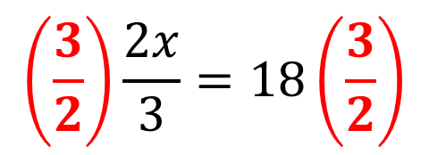

Steps for Solving a Linear Equation
Clear Fractions
Get Rid of ( )
Combine Like Terms:
Same Side of =
Combine Like Terms:
Opposite Side of =
Addition Property
Solve for Variable
Multiplication Property
Use Reciprocal
$$\frac{2x}{3}=18$$
X
$$\left(\frac{3}{2}\right)\frac{2x}{3}=18\left(\frac{3}{2}\right)$$
X
$$x=27$$
OR:

Slide 44

Steps for Solving a Linear Equation
Clear Fractions
Get Rid of ( )
Combine Like Terms:
Same Side of =
Combine Like Terms:
Opposite Side of =
Addition Property
Solve for Variable
Multiplication Property
$$24−2b=6b$$
X

Slide 45


Steps for Solving a Linear Equation
Clear Fractions
Get Rid of ( )
Combine Like Terms:
Same Side of =
Combine Like Terms:
Opposite Side of =
Addition Property
Solve for Variable
Multiplication Property
$$24−2b=6b$$
X
$$24−2b+2b=6b+2b$$
$$24=8b$$
+ ↔ -

Slide 46

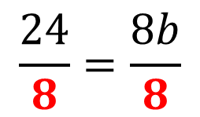
Steps for Solving a Linear Equation
Clear Fractions
Get Rid of ( )
Combine Like Terms:
Same Side of =
Combine Like Terms:
Opposite Side of =
Addition Property
Solve for Variable
Multiplication Property
$$24−2b=6b$$
X
$$24−2b+2b=6b+2b$$
$$24=8b$$
+ ↔ -
$$\frac{24}{8}=\frac{8b}{8}$$
x ↔÷
$$3=b$$

Slide 47

Steps for Solving a Linear Equation
$$6−2y=3y+36$$
Clear Fractions
Get Rid of ( )
Combine Like Terms:
Same Side of =
Combine Like Terms:
Opposite Side of =
Addition Property
Solve for Variable
Multiplication Property
X
Hint:
Start with the variable terms;
Move the smaller one over with the larger one.
-2y < 3y

Slide 48


Steps for Solving a Linear Equation
$$6−2y=3y+36$$
Clear Fractions
Get Rid of ( )
Combine Like Terms:
Same Side of =
Combine Like Terms:
Opposite Side of =
Addition Property
Solve for Variable
Multiplication Property
$$6−2y+2y=3y+36+2y$$
X
$$6=5y+36$$
+ ↔ -

Slide 49


Steps for Solving a Linear Equation
$$6−2y=3y+36$$
Clear Fractions
Get Rid of ( )
Combine Like Terms:
Same Side of =
Combine Like Terms:
Opposite Side of =
Addition Property
Solve for Variable
Multiplication Property
$$6−2y+2y=3y+36+2y$$
X
$$6=5y+36$$
$$6−36=5y+36−36$$
$$−30=5y$$

Slide 50

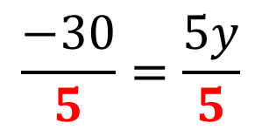
Steps for Solving a Linear Equation
$$6−2y=3y+36$$
Clear Fractions
Get Rid of ( )
Combine Like Terms:
Same Side of =
Combine Like Terms:
Opposite Side of =
Addition Property
Solve for Variable
Multiplication Property
$$6−2y+2y=3y+36+2y$$
X
$$6=5y+36$$
$$6−36=5y+36−36$$
$$−30=5y$$
x ↔÷
$$\frac{−30}{5}=\frac{5y}{5}$$
$$−6=y$$

Slide 51

Steps for Solving a Linear Equation
$$12x−18=8x+10+2x$$
Clear Fractions
Get Rid of ( )
Combine Like Terms:
Same Side of =
Combine Like Terms:
Opposite Side of =
Addition Property
Solve for Variable
Multiplication Property

Slide 52

Steps for Solving a Linear Equation
$$12x−18=8x+10+2x$$
Clear Fractions
Get Rid of ( )
Combine Like Terms:
Same Side of =
Combine Like Terms:
Opposite Side of =
Addition Property
Solve for Variable
Multiplication Property
$$12x−18=10x+10$$

Slide 53



Steps for Solving a Linear Equation
$$12x−18=8x+10+2x$$
Clear Fractions
Get Rid of ( )
Combine Like Terms:
Same Side of =
Combine Like Terms:
Opposite Side of =
Addition Property
Solve for Variable
Multiplication Property
$$12x−18=10x+10$$
$$12x−18−10x=10x+10−10x$$
$$2x−18=10$$
$$2x−18+18=10+18$$
+ ↔ -
$$2x=28$$

Slide 54
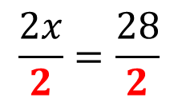

Steps for Solving a Linear Equation
$$12x−18=8x+10+2x$$
Clear Fractions
Get Rid of ( )
Combine Like Terms:
Same Side of =
Combine Like Terms:
Opposite Side of =
Addition Property
Solve for Variable
Multiplication Property
$$12x−18=10x+10$$
$$12x−18−10x=10x+10−10x$$
$$2x−18=10$$
$$2x−18+18=10+18$$
+ ↔ -
$$2x=28$$
$$\frac{2x}{2}=\frac{28}{2}$$
x ↔÷
$$x=14$$

Slide 55
Steps for Solving a Linear Equation
$$12x−18=8x+10+2x$$
Clear Fractions
Get Rid of ( )
Combine Like Terms:
Same Side of =
Combine Like Terms:
Opposite Side of =
Addition Property
Solve for Variable
Multiplication Property
$$12x−18=10x+10$$
$$12x−18−10x=10x+10−10x$$
$$2x−18=10$$
$$2x−18+18=10+18$$
+ ↔ -
$$2x=28$$
$$\frac{2x}{2}=\frac{28}{2}$$
x ↔÷
$$x=14$$

